Slide 1
Saving our Nation's Bridges
Alison Garrett
Unsolicited Report to the American Society of Civil Engineers
29 October 2021

Slide 2

Introduction
The American Road & Transportation Builders Association reports 171.5 million daily crossings on over 45,000 structurally deficient U.S. bridges
Fortunately, lawmakers are earmarking $3.265B for a 5-year
Bridge Reinvestment Program
While significant, it is likely insufficient to address current and future deficiencies

Slide 3
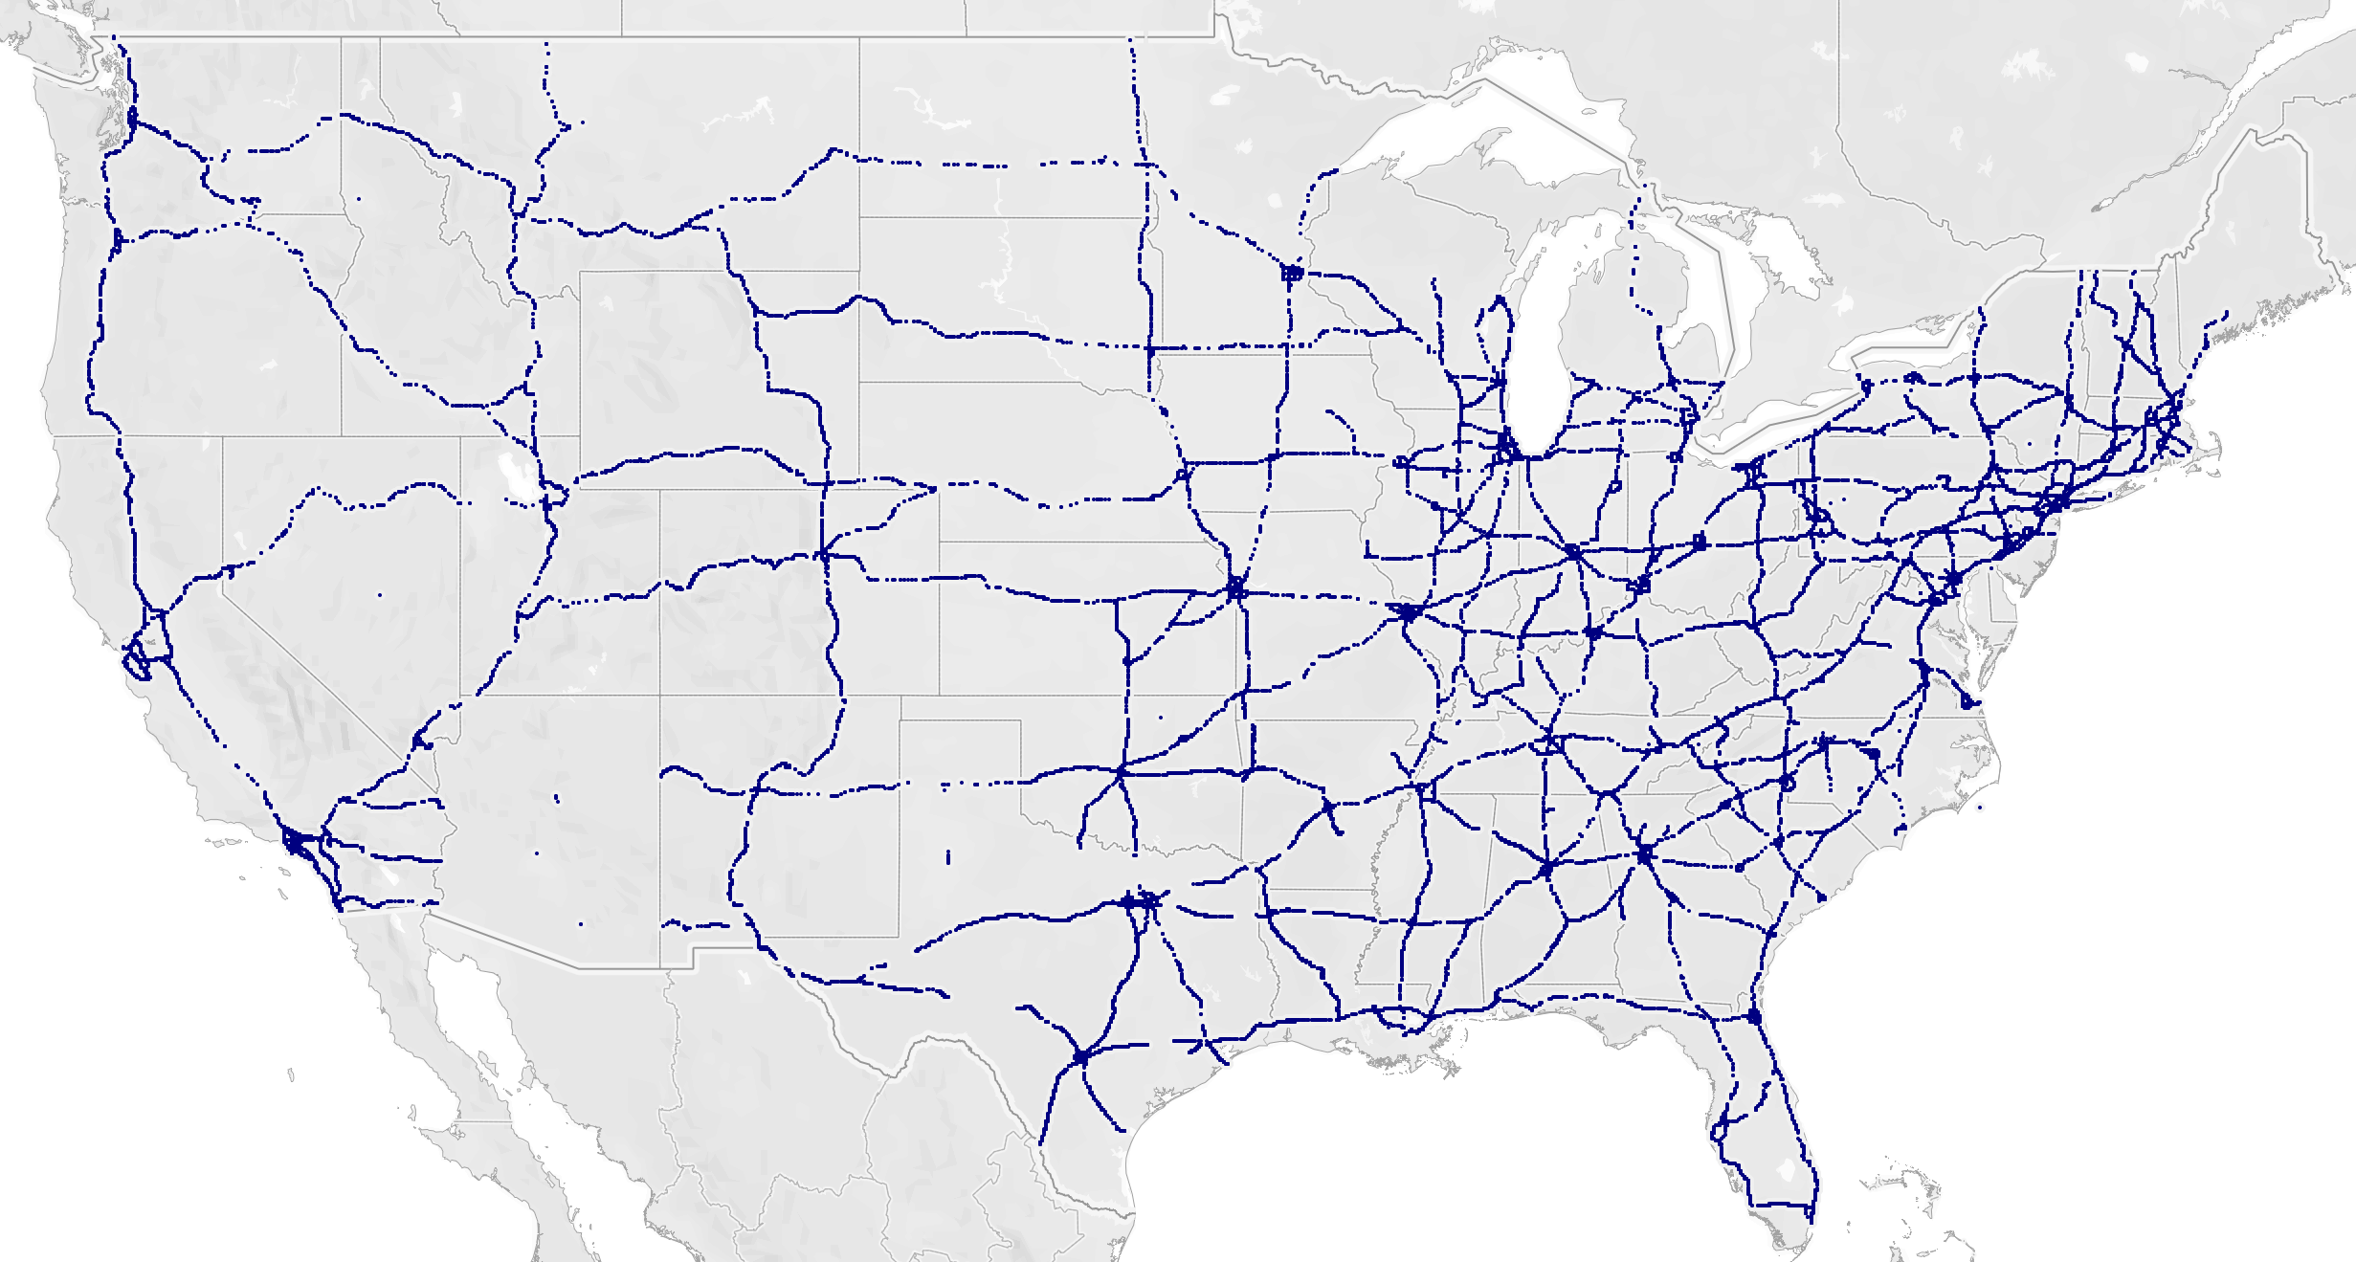
The State of the National Highway System
45,962 National Highway System Bridges in the US
74% are Stringer / Multi-beam, Girder, or Culvert Bridges
Most are Concrete construction
Typical highway overpasses

Slide 4
The State of the National Highway System
76% of NHS Bridges are more than 40 years old
3% (1,363) are classified as Poor - Structurally Deficient and will receive investment
What about the 59% classified as Fair – Needing Repair?

Slide 5
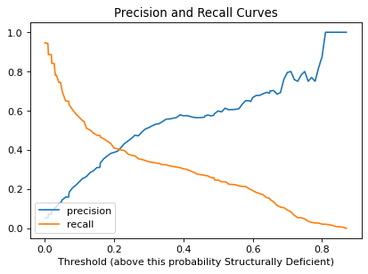
Modeling
Developed an Ensemble Random Forest Classifier to identify Bridge features that are Important when looking at Structural Deficiency
Focused on high Recall to minimize False Negatives
Model provides probability of Structural Deficiency
ROC AUC: 0.875
Threshold: 0.01

Slide 6
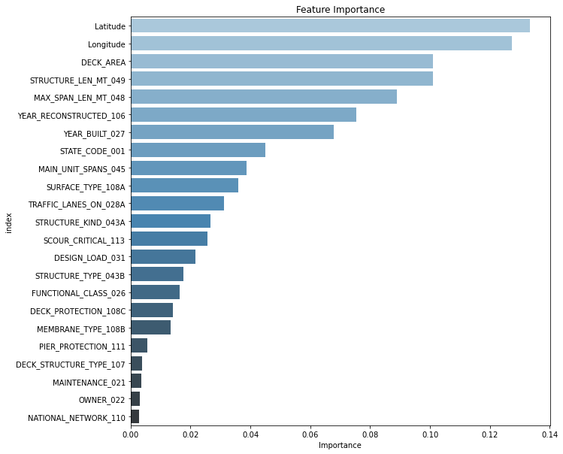
Feature Importance
Location
Dimensions
Age
Type

Slide 7
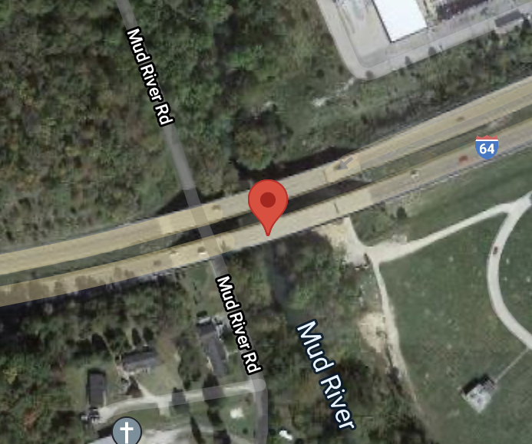
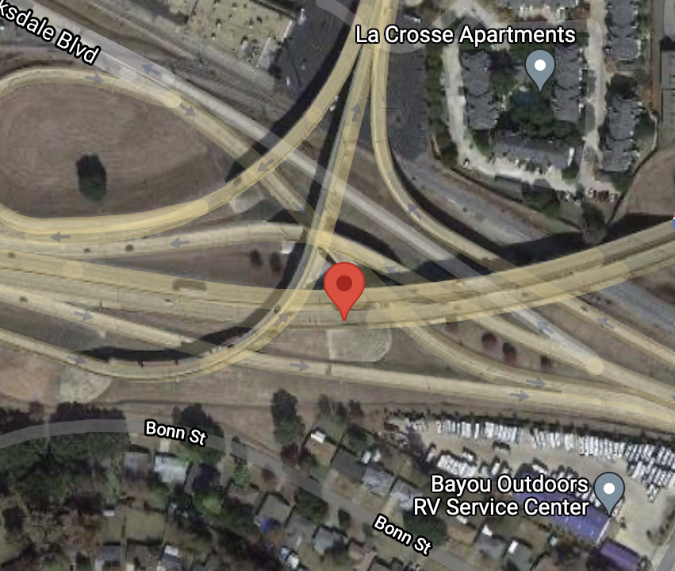
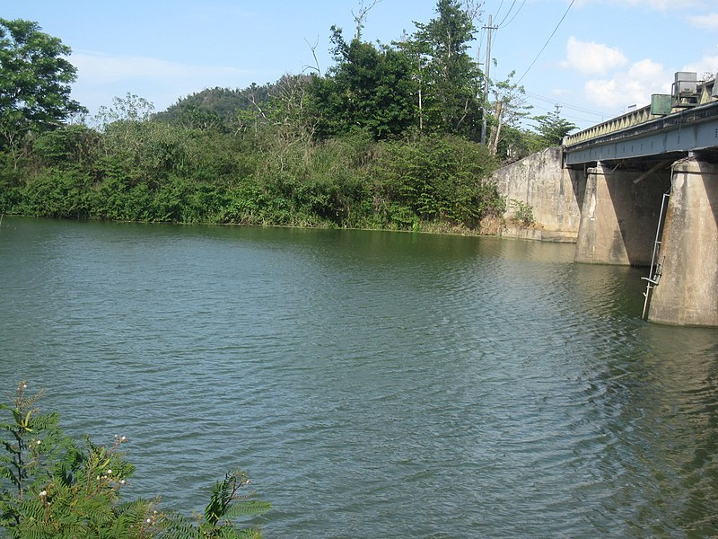
Fair Rated with High Probability Features
I-64 at Mud River Barboursville WV Built: 1959 Daily Traffic: 20,350 Planned Repairs: $31K in 2036 | I-20 at US-71 Bossier City LA Built: 1966 Daily Traffic: 43,950 Planned Repairs: $34K in 2036 | I-15 at Inkom Inkom ID Built: 1962 Daily Traffic: 8,500 Planned Repairs: $13K in 2038 | PR-2 at Guayanilla River Guayanilla PR Built: 1970 Daily Traffic: 37,800 Planned Repairs: $48K in 2025
Photo by Wikimedia Commons / The Eloquent Peasant

Slide 8
Recommendations
Proceed with the repair of Poor Condition, Structurally Deficient Bridges
Refine the Model for improved Precision
Leverage the Model to better identify and prioritize Bridge Reinvestment Funds to address repair / replacement for Bridges in Fair Condition

